Slide 1
File System Interface
Hamid R. Zarandi
h_zarandi@aut.ac.ir

Slide 2
Why file system is important?
For most users, File System (FS) is the most visible aspect of an OS
Provides mechanism to access data/programs on storage
Any FS consists of two distinct parts
A collection of Files
A directory structure that organizes and provides information about all files in the system

Slide 3
What is a file?
File: A contiguous logical address space, logical storage unit
Types
Data
Numeric, text, data, photo, music, etc
Program
Contents defined by file’s creator, many types are
Text file
A sequence of characters
Source file
A sequence of functions
Executable file
A series of code sections that loader can bring into memory and execute

Slide 4
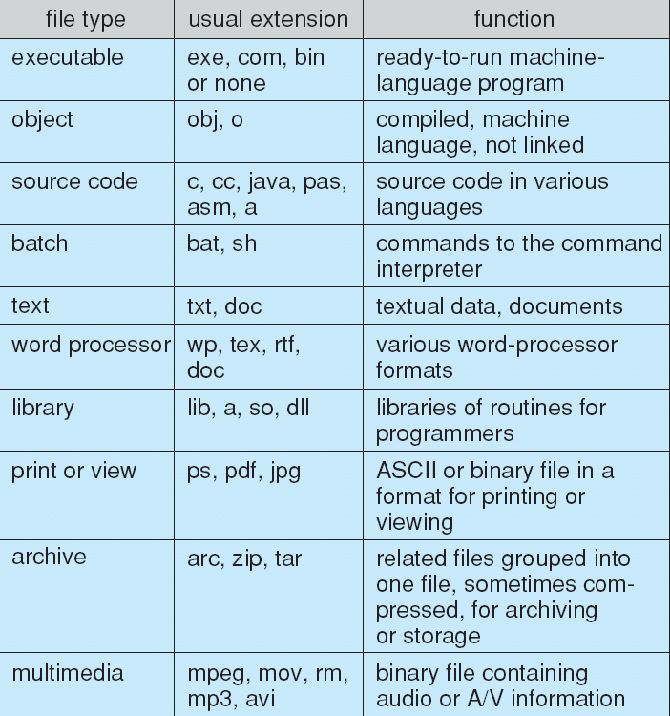
File types; name and extension

Slide 5
File attributes
Name: only information kept in human-readable form
Identifier: unique tag (number) identifies file within file system
Type: needed for systems that support different types
Location: pointer to file location on device
Size: current file size
Protection: controls who can do reading, writing, executing
Time, date, and user identification: data for protection, security, and usage monitoring
Information about files are kept in the directory structure, which is maintained on the disk
Many variations, including extended file attributes such as file checksum

Slide 6
File operations
File is an abstract data type
Create
Write: at write pointer location
Read: at read pointer location
Reposition within file: seek
Delete
Truncate
Open(F_{i})
Search the directory structure on disk for entry F_{i}, and move the content of entry to memory
Close (F_{i})
Move the content of entry F_{i} in memory to directory structure on disk

Slide 7
Open files
Open (Fi): move the content of a file to memory
Search the directory structure on disk for the file
To avoid constant searching: open() system should be called before a file is first used
Open-file table: tracks all open files
Per-process table
System-wide table
When the file is no longer being actively used, it is closed by the process, and OS removes its entry from open-file table using Open Count

Slide 8
Other information for an open file
File pointer
Pointer to last read/write location, per process that has the file open
File-open count
Counter of the number of times a file is open to allow removal of data from open-file table when last process closes it
Disk location of the file
Moving data access information to memory
Access rights
Per-process access mode information

Slide 9
Locking in open file
File locks allows one process to lock a file, prevent other process from gaining access to it
Similar to reader-writer locks
Shared lock similar to reader lock
Several processes can acquire concurrently
Exclusive lock similar to writer lock
Only on process can acquire it

Slide 10
Other locking mechanisms
Mandatory
OS will prevent access until the exclusive lock is released
Windows®
Advisory
OS will not prevent applications from acquiring access to a file, and the application must be developed to manually acquire the lock before accessing the file
UNIX®

Slide 11
File structure
Files must conform to structures that are understood by OS
OS requires an executable file has a specific structure; it can determine where in memory to load the file, what the location of first instruction is
Support of multiple file structures?
Size of OS could be big; it needs to contain codes to support these file structures
Severe problems may result if OS does not support some file structures

Slide 12
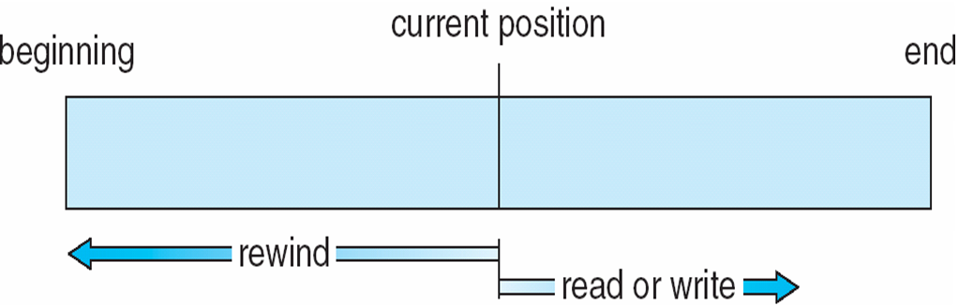
File access methods: 1) Sequential access
Simplest and most common
Based on tape model of a file
Processing information in a file is in order: one record after the other
A read operation, read_next()
Reads the next portion of the file and automatically advances a file pointer
A write operation, write_next()
Appends to the end of the file and advances to the end of the newly written information

Slide 13
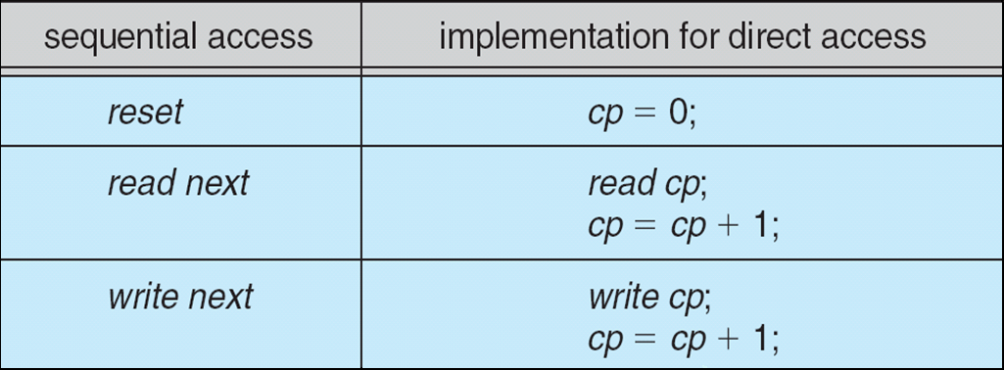
File access methods: 2) Direct access
Based on a disk model of a file
A file is made up of fixed-length logical records that allow programs to read and write records rapidly in no particular order
Immediate access to large amount of information
Databases are often of this type
read(n) rather than read_next()
n is block number
write(n) rather than write_next()

Slide 14
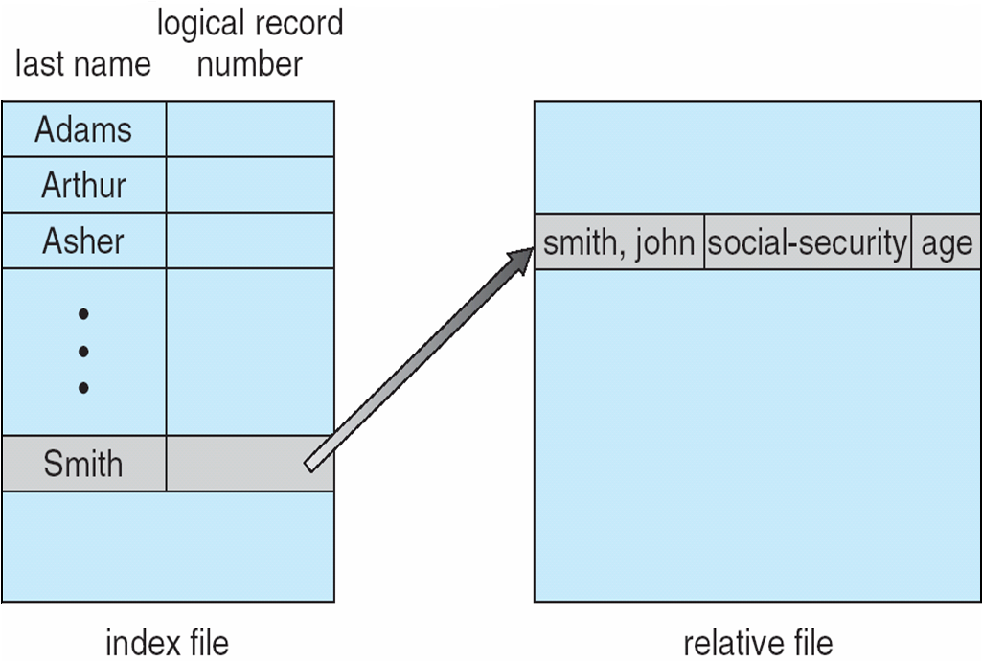
Other access methods
Can be built on top of base methods
Creation of an index for a file
Having pointers to various blocks
Keep index in memory for fast determination of location of data
IBM's indexed sequential access method (ISAM)

Slide 15
Directory & Disk Structure

Slide 16
Disk structure
Disk can be subdivided into partitions
Disks or partitions can be RAID protected against failure
Disk or partition can be used raw (without a file system), or formatted
Partitions also known as minidisks, slices
Entity containing file system known as a volume
Each volume contains information about the files in the system
This information is kept in entries in a device directory or volume table of contents
The device directory, (known as the directory), records information such as name, location, size, and type for all files on that volume.

Slide 17
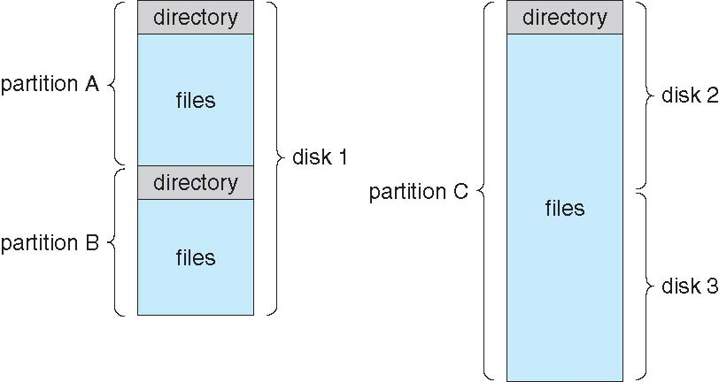
A typical file-system organization

Slide 18
Types of file systems
Systems frequently have many file systems, some general- and some special- purpose
Consider Solaris has
tmpfs – memory-based volatile FS for fast, temporary I/O
objfs – interface into kernel memory to get kernel symbols for debugging
ctfs – contract file system for managing daemons
lofs – loopback file system allows one FS to be accessed in place of another
procfs – kernel interface to process structures
ufs, zfs – general purpose file systems

Slide 19
Directory
Directory
Can be viewed as a symbol table that translates file names into their directory entries
Both the directory structure and the files reside on disk
Operations on directories
Search for a file
Create a file
Delete a file
List a directory
Rename a file
Traverse the file system

Slide 20
Directory organization
1) Single-level directories
2) Two-level directories
3) Tree-structure directories
4) Acyclic-graph directories
5) General graph directories

Slide 21
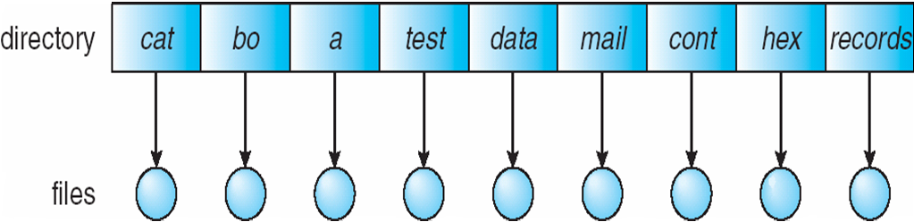
1) Single-level directory
A single directory for all users
Naming problem: they must have unique names
Grouping problem

Slide 22
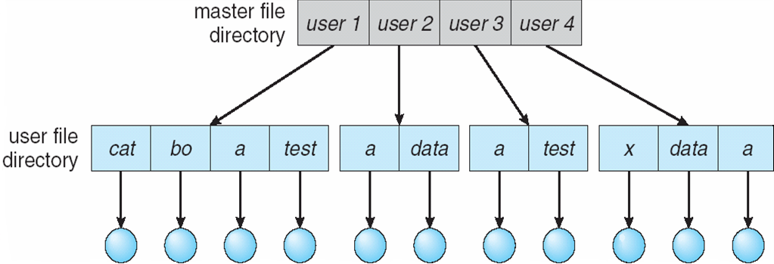
2) Two-level directory
Separate directory for each user
Can have the same file name for different users
Efficient searching
Path name: two level path, e.g., /userN/file.txt
No grouping capability
Sharing problem

Slide 23
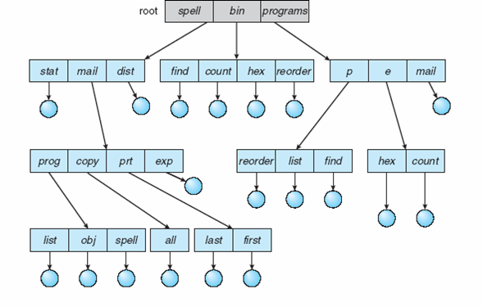
3) Tree-structured directories
Efficient searching
Grouping capability
Two types of path names
Absolute path name
Begins at the root and follows a path down to the specified file
Relative path name
A path from the current directory
Deleting a directory
1. Not allowed if is not empty
2. Have an option of delete internal nodes
Sharing problem

Slide 24
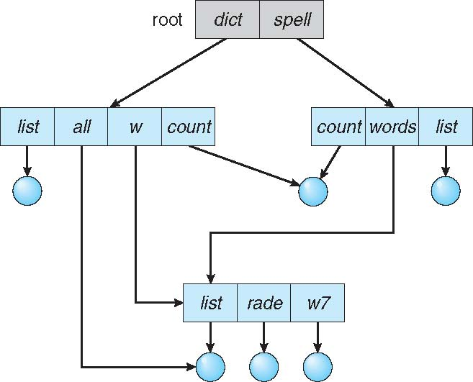
4) Acyclic-graph directories
Have shared subdirectories and files
Only one actual file exists, so any changes made by one person are immediately visible to the other
Methods of shared files implementation
1) Link
Another name (pointer) to an existing file
Resolve the link: follow pointer to locate the file
2) Duplicate all information about the file
Both entries are identical and equal
Consistency problem (why?)
Deletion & Traversing problems (?)

Slide 25
Deletion possibilities?
1) Remove the file content whenever anyone deletes it
Dangling pointers: pointing to the nonexistent file
What if the remaining file pointers contain actual disk addresses?
Easy with soft-links (symbolic links)
2) Preserve the file until all references to it are deleted
Hard links
Counting number of references

Slide 26
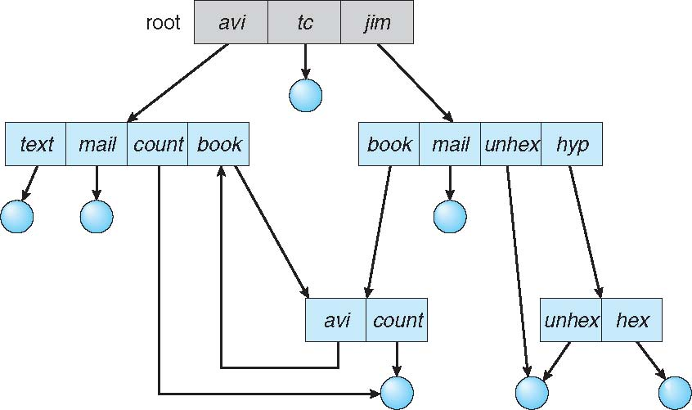
4) General graph directories
Remove problem of no cycles
How do we guarantee no cycles?
1) Allow only links to file not subdirectories
2) Garbage collection
3) Every time a new link is added use a cycle detection algorithm to determine whether it is OK

Slide 27
File System Mounting

Slide 28
File system mounting
A file system must be mounted before it can be accessed
A unmounted file system is mounted at a mount point
Mount point
The location within the file structure where the file system is to be attached

Slide 29
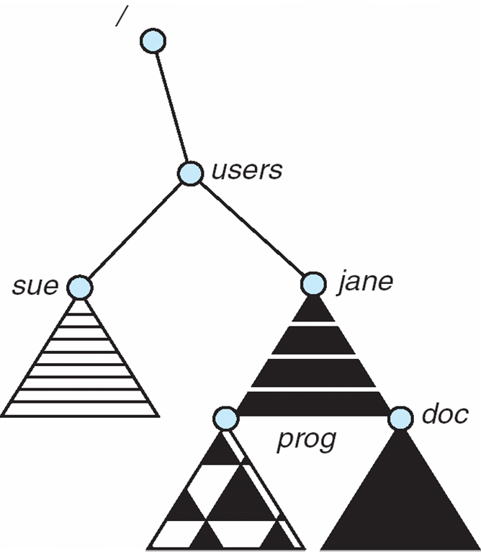
File system mounting & mount point
``
(a) Existing FS (b) unmonted FS
The mounted FS

Slide 30
File Sharing & Protection

Slide 31
File sharing
Sharing of files on multi-user systems is desirable
Sharing may be done through a protection scheme
On distributed systems, files may be shared across a network
Network File System (NFS) is a common distributed file-sharing method
If multi-user system
User IDs identify users, allowing permissions and protections to be per-user Group IDs allow users to be in groups, permitting group access rights
Owner of a file/directory
Group of a file/directory

Slide 32
File sharing – Remote file system
Uses networking to allow file system access between systems
Manually via programs like FTP
Automatically, seamlessly using distributed file systems
Semi automatically via the world wide web
Client-server model allows clients to mount remote file systems from servers
Server can serve multiple clients
Client and user-on-client identification is insecure or complicated
NFS is standard UNIX client-server file sharing protocol
CIFS (Common Internet FS) is standard Windows protocol
Standard OS file calls are translated into remote calls
Distributed Information Systems (distributed naming services) such as LDAP, DNS, NIS, Active Directory implement unified access to information needed for remote computing

Slide 33
File sharing – Failure modes
All file systems have failure modes
For example corruption of directory structures or other non-user data (metadata)
Remote file systems add new failure modes, due to network failure, server failure
Recovery from failure can involve state information about status of each remote request
Stateless protocols such as NFS v3 include all information in each request, allowing easy recovery but less security

Slide 34
File sharing – Consistency semantics
Specify how multiple users are to access a shared file simultaneously
Similar to process synchronization algorithms
Tend to be less complex due to disk I/O and network latency (for remote file systems)
Andrew File System (AFS)
Implemented complex remote file sharing semantics
Unix file system (UFS)
Writes to an open file visible immediately to other users of the same open file
Sharing file pointer to allow multiple users to read and write concurrently
AFS has session semantics
Writes only visible to sessions starting after the file is closed

Slide 35
Protection
File owner/creator should be able to control
What can be done
By whom
Types of access
Read
Write
Execute
Append
Delete
List

Slide 36
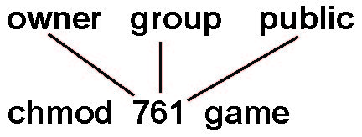
Access lists and groups
Mode of access: read, write, execute
Three classes of users on Unix/Linux
RWX
a) owner access 7 ⇒ 1 1 1 RWX
b) group access 6 ⇒ 1 1 0
RWX
c) public access 1 ⇒ 0 0 1
Ask manager to create a group (unique name), say G, and add some users to the group
For a particular file (say game) or subdirectory, define an appropriate access
Attach a group to a file chgrp G game

Slide 37
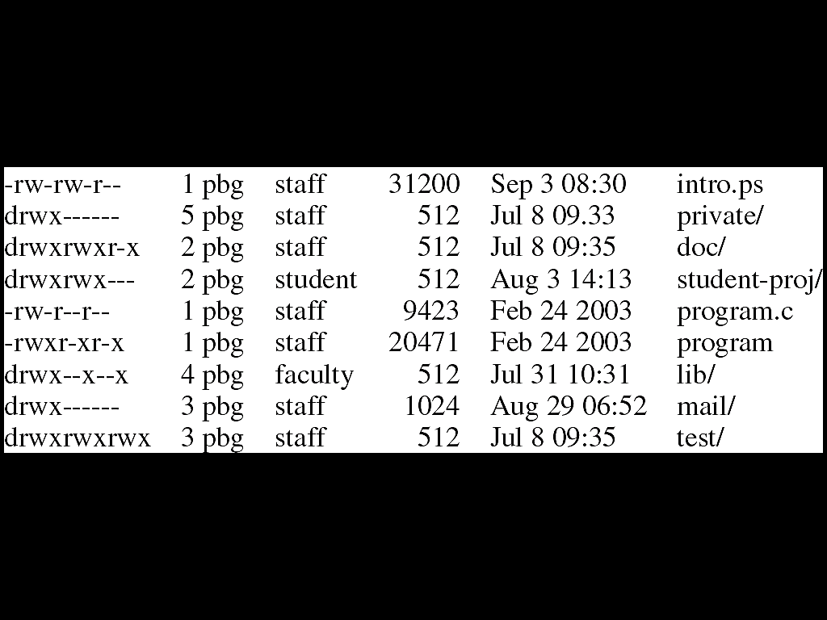
A sample UNIX directory listing

Slide 38
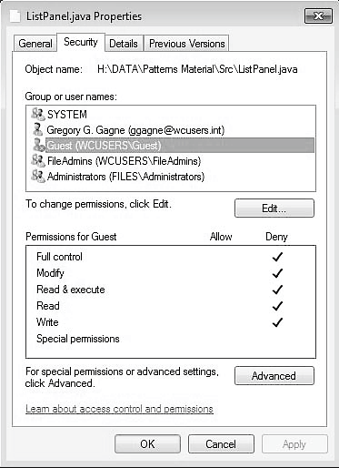
Windows 7 access control list management

Slide 39

Questions?

